Slide 1
Introduction to Many-Body Potentials
Yuan Ping
Credits: Dane Morgan

Slide 2
Outline
Pair vs. many-body potentials
Limitations of pair potentials
Many-Body Potentials
Bond Order potentials
Embedded atom potentials
Charge Transfer terms
The ReaxFF
CHARM
Machine Learning Potentials – IN PROGRESS???
Coarse-Grained Potentials
Speed and scaling of potentials

Slide 3
Pair and Many-Body Potentials
Pair interaction φ(r_{i},r_{j}),
Energy
r
Pair Potential: A Hamiltonian for a system of particles that includes only terms of the form φ(r_{i},r_{j}), which include interactions between only two atoms at a time. Generally φ(r_{i},r_{j}) is a central-force, i.e., φ(r_{i},r_{j}) = φ(r_{ij}=|r_{i} – r_{j}|).
Non-Pair Potential (or Many-Body Potential): A Hamiltonian for a system of particles that includes terms which cannot be written only as functions of two atoms at a time, e.g., φ(r_{i},r_{j,,}r_{k}).
Confusing terminology alert: Classical potentials that depend on 3 or more atoms positions at once are “many-body”, quantum potentials that depend on 2 or more atom positions at once are “many-body”.
Classical interatomic interactions do not have to involve only pair interactions (even though the basic quantum mechanical interactions are all pairwise!) - In fact, we know that pair potentials are inadequate…

Slide 4
Some Limitations of Pair Potentials Perfect Cauchy Relation
(Daw, et al., Mat Sci Reports ’93)
(Finnis, Interatomic Forces Cond. Matt.)
Cauchy relation c₁₂=c₄₄ ⇒ c₁₂/c₄₄=1
Any solid* described with a central pair potential satisfies Cauchy relation – but real materials don’t!
c₁₂=c_{xxyy}
Strain ε
y
Stress σ
System | c₁₂/c₄₄
Lennard-Jones, Morse | 1
Ar | 1.1
Kr | 1.0
Ni | 1.2
Cu | 1.6
Pd | 2.5
Ag | 2.0
Pt | 3.3
Au | 3.7
x
c₄₄=c_{yzyz}
z
Strain ε
y
Stress σ
* I think this is general but perhaps there are some constraints?

Slide 5
Some Limitations of Pair Potentials Vacancy and Cohesive Energy
(Daw, et al., Mat Sci Reports ’93)
Vacancy-cohesive E relation E_{v} (no relaxation)=E_{coh}
Any solid (single constituent, 1 atom/unit cell) described with a central pair potential satisfies vacancy-cohesive E relation – but real materials don’t!
E_{vac}
= E_{N-1}(1 vacancy) - E_{N-1}(perfect)
System | E_{vac}/E_{coh}
Lennard-Jones, Morse | 1
Ar | 0.95
Kr | 0.66
Ni | 0.31
Cu | 0.37
Pd | 0.36
Ag | 0.39
Pt | 0.26
Au | 0.23
E_{coh}= E(solid)-E(gas)
Au: E_{coh} = 3.8 eV, E_{vac} = 0.87eV
Kittel, Intro Sol State Phys.

Slide 6
Some Limitations of Pair Potentials Scaling of Cohesive Energy with Coordination Z
(Daw, et al., Mat Sci Reports ’93)
BCC
FCC
Pair potential: Bond strength is constant
Real metal: Bond strength decreases ~Z^{-1/2} (very approximately)

Slide 7
General Challenges for Potentials
Including essential physics of materials (e.g., electrostatics in ionic materials)
Multibody interactions
Large change in electronic state
Bond Breaking (e.g., defects, creating surfaces, ...)
Charge transfer (e.g., Si⁰⁺-Si⁰⁺ + 2 O⁰⁺-O⁰⁺ → 2Si⁴⁺O₂⁴⁻)
Directional bonding (e.g., C-C in graphite (sp2 bonding) and diamond (sp3 bonding))
Magnetic effects (e.g., Fe)
metal-insulator transition (e.g., high-pressure phases)
Superconductivity (e.g., MgB₂)

Slide 8
Adding in Multibody Effects Bond Order Potentials (1)
D.W. Brenner, Phys. Stat. Sol. ‘00
b_{ij} includes the many-body effects
b_{ij} = z^{-1/2} “fixes” the coordination dependence problem of simple pair potential
Potentials of this form include Tersoff and Finnis-Sinclair

Slide 9
Adding in Multibody Effects Bond Order Potentials (2)
r
Z=1, E_{coh} = φ(r), E_{coh}/bond = φ(r)
r
Z=2, E_{coh} = 3φ(r)/√2, E_{coh}/bond = φ(r)/√2
r
r
bond energy changes with coordination!

Slide 10
A Multibody Potential For Metals Embedded Atom Method (EAM) (1)
(Daw, et al., Mat Sci Reports ’93)
Key new idea: Embedding!
Embedding contribution: each atom is embedded in a host electron gas created by neighboring atoms (Metallic picture)
Have to fit p,G(p), and U(R) to match experimental (or more accurate calculated) data: fit to cohesive energy, vacancy energies, elastic properties, phonon frequencies, etc.
Not equivalent to a pair potential (except when G is a linear function) – can be mapped onto bond-order form (I think?)

Slide 11
Adding in Multibody Effects Embedded Atom Method (EAM) (2)
r
E_{coh} = U(r) + 2G(ρ(r)), E_{coh}/bond = U(r) + 2G(ρ(r))
r
Z=2, E_{coh} = 3U(r) + 3G(2ρ(r)), E_{coh}/bond = U(r) + G(2ρ(r))
r
r
If G(2ρ(r)) ≠ 2G(ρ(r)) (G is nonlinear) then the bond energy changes with coordination!

Slide 12
Pt Binding – Many-Body Effects Modified EAM (MEAM) and DFT
Bulk atom
Surface atom
DFT shows strong scaling of bond strength with number of neighbors (more neighbors, weaker bonds)
EAM (technicallly the Modified EAM (MEAM), which is EAM with some extra terms) can reproduce this effect

Slide 13
Adding in Charge Transfer Environment Dependent Electrostatics (1)
E(q) either want to take or give electrons compared to other atoms (e.g., with NaCl, Cl will want to take and Na will want to give)
Optimize whole system to give minimum electrostatic energy while maintaining charge neutrality – this will transfer some charge, but differing amounts depending on positions.
Captures effects of charge transfer on the electrostatics (and can combine with bond-order methods to get many body effects as well).

Slide 14
Adding in Charge Transfer Environment Dependent Electrostatics (2)
Na solid
No charge transfer
Cl gas
No charge transfer
Neutral NaCl lattice with no charge transfer
+
Can lower energy by moving charge from Na to Cl and forming Na⁺Cl⁻

Slide 15
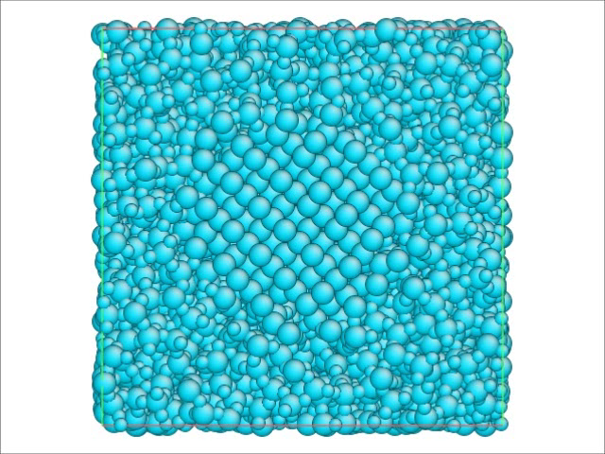
Charge Optimized Many-Body (COMB) Potentials
Si nanocluster embedded in an amorphous SiO₂ matrix
Si blue (neutral), Si red (charged +), O purple (charged -)
Sinnott Si in SiO2 COMB Charge Equilibration
Courtesy of Susan Sinnott, Univ. of Florida.

Slide 16
A State of the Art Potential ReaxFF (H-C, Si-O, Al-O)
E_{system} = (C-H case)
W.A. Goddard III, et al., J. Phys. Chem., ’01,’03; Phys. Rev. B ‘04
+ E_{bond}
Contains bond-order information – tells the interacting atoms to only see a bond when within a certain range
+ E_{over}
+ E_{under}
Correct the bond-order when it over or under estimates the number of bonds expected from valence electrons (e.g., 4 for C, 3 for Al)
+ E_{pen}
+ E_{val}
Energy associated with deviations of bonds from their ideal bending and twisting angles (e.g., 120º sp2 bonding)
+ E_{tors}
+ E_{conj}
Extra energy associated with pi bond conjugation (from extended networks of pi bonds)
+ E_{vdWaals}
Long-range dispersion forces, short range electron overlap forces
+ E_{Coulomb}
Electrostatic interactions with charges transfer allowed
58 Unknown parameters!! Fit to heats of formations, bond lengths, bond angles from quantum calculations and experiment. Quite accurate.
Update – B-C Reaxff has 234 parameters!! Worst I know about. TMS talk, 2017.

Slide 17
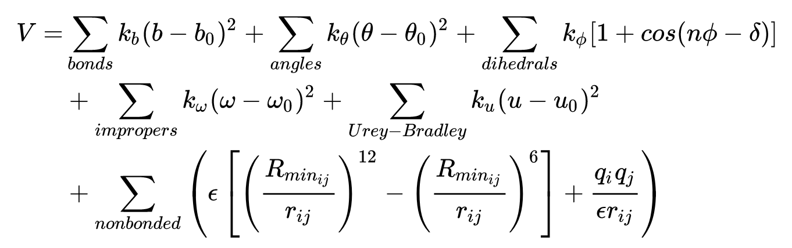
CHARM
Widely used potential for (bio-)molecular system. Part of what led to the 2013 chemistry Nobel Prize for Martin Karplus.
Equations are strongly driven by chemical insight with bonding and non-bonding terms, where bonding cover the energies of distorting molecular units.
https://en.wikipedia.org/wiki/CHARMM
https://www.charmmtutorial.org/index.php/The_Energy_Function
https://www.ks.uiuc.edu/Training/Tutorials/science/forcefield-tutorial/forcefield-html/node5.html

Slide 18
Machine Learning Potentials
Recently researchers have been using Machine Learning algorithms to create a potential.
Idea is to consider a large database of energies andforces, call this data Y, and properties of the atomic positions, call this X, and then fit Y(X) not with a physically motivated function but with a machine learned form (e.g., linear regression, Gaussian Process regression, neural networks).
A key complexity is that X should be translationally, rotationally and permutation invariant, which atomic coordinates are not. This can be treated by assuming Yi is the energy of atom i and Xi are a vector of rotationally symmetric functions of the local (<1nm) environment around atom i and fitting Yi(Xi). Then the total energy is E=sum_i Yi. Sometimes one needs to add long-range physics (e.g., electrostatics) in separately.
Generally need more fitting data than traditional potentials (but one can get this from quantum simulations)
See, e.g., Mishin, Acta Mat ‘21

Slide 19
Coarse Grained Potentials
Remove unnecessary degrees of freedom by grouping together atoms and parameterizing interactions between atom groups
Speed up calculations
E.g., CH₃ or CH₂ might be treated as one object in a protein
Remove unnecessary degrees of freedom by taking out distance dependence on a fixed lattice
Speed up calculations
E.g., in the Cluster Expansion potential we use E = E(Cu-Cu)+E(Cu-Au)+E(Au-Au) to describe nearest-neighbor interactions in a Cu-Au alloy on a fixed fcc lattice – no distance dependence makes this simpler!

Slide 20
Speed and Scaling with Potentials
Each atom interacts with others within a cutoff, typically 5-6 A (a local interaction). This means there is a fixed amount of calculation per atom to get an energy or force if you track the neighbors efficiently. Thus the amount of calculation in a potential scales as O(N) (N=# of atoms). This is called linear scaling. So doubling your system size will typically double the time of the calculation, all other things being equal.
Quantum calculations generally scale as O(N²lnN) or worse.
You can also parallelize calculations on many atoms with potentials very well, often up to 100-1000 processors with almost linear scaling. So scaling of time per calculation is more like O(N atoms / N proc)
The amount of work done to get the energies/forces is quite different between potentials, e.g., there is about 1000x as many calculations in ReaxFF than Lennard-Jones, so it is ~1000x slower. Machine learning potentials are similar in speed (~10-100x faster than ReaxFF, 10-100x slower than Lennard-Jones).

Slide 21
Summary
Many-body potentials include interactions beyond just sums of pairwise interactions. Pair potentials (e.g., Lennard-Jones) cannot explain all the physics in materials.
There are many kinds of many-body potentials which are appropriate for different kinds of physics and vary in speed and difficulty of fitting. Machine learning potentials can model almost any physics but may require a lot of training data.
Potentials are generally about 10³-10⁶ times faster than ab initio methods to find energies/forces for a few atoms (millisecond per single energy/force calculation of the system) and scale linearly with number of atoms N (vs. O(N²ln(N) or worse for ab initio methods).

